Slide 1
Software Evolution and Maintenance
A Practitioner’s Approach
Chapter 4
Reengineering
Notes:
Handouts
------------------------------------------------------------------
------------------------------------------------------------------
-------------------------------------------------------------------
--------------------------------------------------------------------

Slide 2
Outline of the Chapter
4.1 General Idea
4.2 Reengineering Concepts
4.3 A General Model for Software Engineering
4.3.1 Types of Changes
4.3.2 Software Reengineering Strategies
4.3.3 reengineering Variations
4.4 Reengineering Process
4.4.1 Reengineering Approaches
4.4.2 Source Code Reengineering Reference Model
4.4.3 Phase Reengineering Model
4.5 Code Reverse Engineering
4.6 Techniques used for Reverse Engineering
4.6.1 lexical Analysis
4.6.2 Syntactic Analysis
4.6.3 Control Flow Analysis
4.6.4 Data Flow Analysis
4.6.5 Program Slicing
4.6.6 Visualization
4.7 DE compilation versus Reverse Engineering
4.8 Data Reverse Engineering
4.8.1 Data Structure Extraction
4.8.2 Data Structure Conceptualization
4.9 Reverse Engineering Tools
Notes:
Handouts

Slide 3
4.1 General Idea
Reengineering is the examination, analysis, and restructuring of an existing software system to reconstitute it in a new form, and the subsequent implementation of the new form.
The goal of reengineering is to:
  understand the existing software system artifacts, namely, specification, design, implementation, and documentation, and
  improve the functionality and quality attributes of the system.
Software systems are reengineered by keeping one or more of the following four general objectives in mind:
  Improving maintainability.
  Migrating to a new technology.
  Improving quality.
  Preparing for functional enhancement.
Notes:
Handouts

Slide 4
4.2 Reengineering Concepts
Abstraction and Refinement are key concepts used in software development, and both the concepts are equally useful in reengineering.
It may be recalled that abstraction enables software maintenance personnel to reduce the complexity of understanding a system by:
  (i) focusing on the more significant information about the system; and
  (ii) Hiding the irrelevant details at the moment.
On the other hand, refinement is the reverse of abstraction.
Principle of refinement: The level of abstraction of the representation of the system is gradually decreased by successively replacing some aspects of the system with more details.
Notes:
Handouts

Slide 5
4.2 Reengineering Concepts
A new software is created by going downward from the top, highest level of abstraction to the bottom, lowest level. This downward movement is known as forward engineering.
Forward engineering follows a sequence of activities: formulating concepts about the system to identifying requirements to designing the system to implementing the design.
On the other hand, the upward movement through the layers of abstractions is called reverse engineering.
Reverse engineering of software systems is a process comprising the following steps:
  (i) analyze the software to determine its components and the relationships among the components,
  (ii) represent the system at a higher level of abstraction or in another form.
Decompilation is an example of Reverse Engineering, in which object code is translated into a high-level program.
Notes:
Handouts

Slide 6
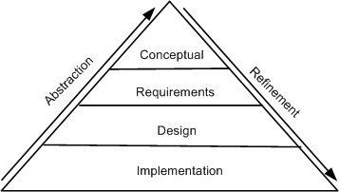
4.2 Reengineering Concepts
The concepts of abstraction and refinement are used to create models of software development as sequences of phases, where the phases map to specific levels of abstraction or refinement, as shown in Figure 4.1.
The four levels are:
  Conceptual,
  Requirements,
  Design, and
  Implementation.
The refinement process:
why? ! what? ! what & how? ! how?
The abstraction process:
how? ! what & how? ! what? ! why?
Figure 4.1 levels of abstraction and refinement © IEEE, 1992
Notes:
Handouts

Slide 7
4.3 A General Model For Software Reengineering
The reengineering process accepts as input the existing code of a system and produces the code of the renovated system.
The reengineering process may be as straightforward as translating with a tool the source code from the given language to source code in another language.
For example, a program written in BASIC can be translated into a new program in C.
The reengineering process may be very complex as explained below:
  • recreate a design from the existing source code.
  • find the requirements of the system being reengineered.
  • compare the existing requirements with the new ones.
  • remove those requirements that are not needed in the renovated system.
  • make a new design of the desired system.
  • code the new system.
Notes:
Handouts

Slide 8
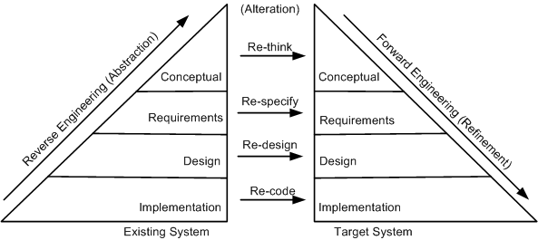
4.3 A General Model For Software Reengineering
The model in Figure 4.3 proposed by Eric J. Byrne suggests that reengineering is a sequence of three activities:
  – reverse engineering, re-design, and forward engineering
  – strongly founded in three principles, namely, abstraction, alteration, and refinement.
Figure 4.3 General model of software reengineering © IEEE, 1992
Notes:
Handouts

Slide 9
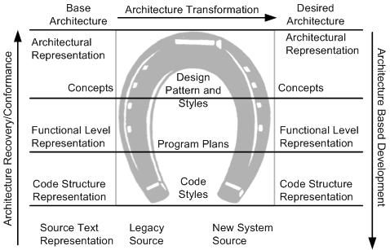
4.3 A General Model For Software Reengineering
A visual metaphor called horseshoe, as depicted in Figure 4.4, was developed by Kazman et al. to describe a three-step architectural reengineering process.
Three distinct segments of the horseshoe are the left side, the top part, and the right side. Those three parts denote the three steps of the reengineering process.
Figure 4.4 Horseshoe model of reengineering © IEEE, 1998
Notes:
Handouts

Slide 10
4.3 A General Model For Software Reengineering
Another common term used by practitioners of reengineering is rehosting.
Rehosting means reengineering of source code without addition or reduction of features in the transformed targeted source code.
Rehosting is most effective when the user is satisfied with the system’s functionality, but looks for better qualities of the system.
Examples of better qualities are improved efficiency of execution and reduced maintenance costs.
Notes:
Handouts

Slide 11
4.3.1 Types of Change
Based on the type of changes required, system characteristics are divided into groups: rethink, respecify, redesign, and re-code.
Recode:
Implementation characteristics of the source program are changed by re-coding it. Source-code level changes are performed by means of rephrasing and program translation.
In the latter approach, a program is transformed into a program in a different language. On the other hand, rephrasing keeps the program in the same language
Examples of translation scenarios are compilation, decompilation, and migration.
Examples of rephrasing scenarios are normalization, optimization, refactoring, and renovation.
Redesign:
The design characteristics of the software are altered by re-designing the system. Common changes to the software design include:
  (i) restructuring the architecture;
  (ii) Modifying the data model of the system; and
  (iii) replacing a procedure or an algorithm with a more efficient one.
Notes:
Handouts

Slide 12
4.3.1 Types of Change
Respecify:
This means changing the requirement characteristics of the system in two ways:
  (i) change the form of the requirements, and
  (ii) change the scope of the requirements.
Rethink:
Re-thinking a system means manipulating the concepts embodied in an existing system to create a system that operates in a different problem domain.
It involves changing the conceptual characteristics of the system, and it can lead to the system being changed in a fundamental way.
Moving from the development of an ordinary cellular phone to the development of smartphone system is an example of Re-think.
Notes:
Handouts

Slide 13
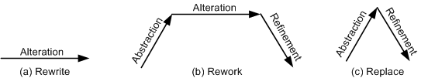
4.3.2 Software Reengineering Strategies
Three strategies that specify the basic steps of reengineering are rewrite, rework, and replace.
Rewrite strategy:
This strategy reflects the principle of alteration. By means of alteration, an operational system is transformed into a new system, while preserving the abstraction level of the original system. For example, the Fortran code of a system can be rewritten in the C language.
Figure 4.5 Conceptual basis for reengineering strategies © IEEE, 1992
Notes:
Handouts

Slide 14
4.3.2 Software Reengineering Strategies
Rework strategy:
The rework strategy applies all the three principles.
Let the goal of a reengineering project is to replace the unstructured control flow constructs, namely GOTOs, with more commonly used structured constructs, say, a “for” loop.
classical, rework strategy based approach is as follows:
  • Application of abstraction: By parsing the code, generate a control-flow graph (CFG) for the given system.
  • Application of alteration: Apply a restructuring algorithm to the control-flow graph to produce a structured control-flow graph.
  • Application of refinement: Translate the new, structured control-flow graph back into the original programming language.
Figure 4.5 Conceptual basis for reengineering strategies © IEEE, 1992
Notes:
Handouts

Slide 15
4.3.2 Software Reengineering Strategies
Replace strategy:
The replace strategy applies two principles, namely, abstraction and refinement.
To change a certain characteristic of a system:
  (i) the system is reconstructed at a higher level of abstraction by hiding the details of the characteristic; and
  (ii) a suitable representation for the target system is generated at a lower level of abstraction by applying refinement.
Let us reconsider the GOTO example. By means of abstraction, a program is represented at a higher level without using control flow concepts.
Next, by means of refinement, the system is represented at a lower level of abstraction with a new structured control flow.
Figure 4.5 Conceptual basis for reengineering strategies © IEEE, 1992
Notes:
Handouts

Slide 16
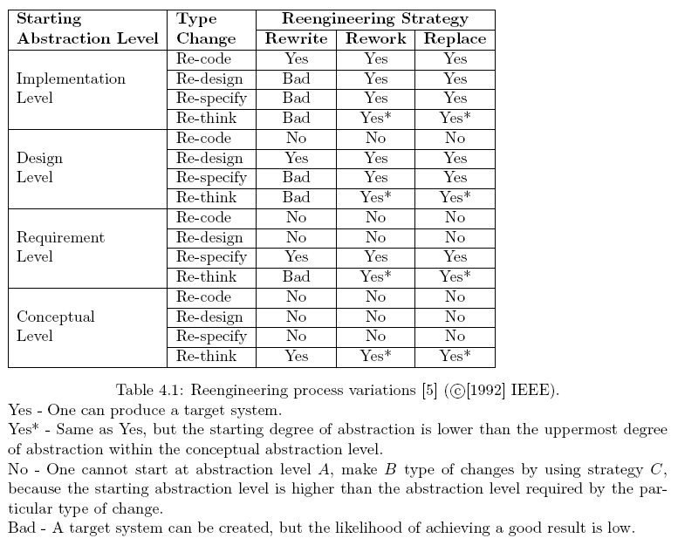
4.3.3 Reengineering Variations
Notes:
Handouts

Slide 17
4.4 Reengineering Process
An ordered set of activities designed to perform a specific task is called a process.
For example, in the software development domain, the Waterfall process model is widely used in developing well-understood software systems.
Process models are used to comprehend, evaluate, reason about, and improve processes.
We will discuss five process models for software reengineering.
The five approaches are different in two aspects:
  (i) the extent of reengineering performed, and
  (ii) the rate of substitution of the operational system with the new one.
Notes:
Handouts

Slide 18
4.4.1 Reengineering Approaches
1- Big Bang Approach
The “Big Bang” approach replaces the whole system at once.
Once a reengineering effort is initiated, it is continued until all the objectives of the project are achieved and the target system is constructed.
This approach is generally used if reengineering cannot be done in parts.
For example, if there is a need to move to a different system architecture, then all components affected by such a move must be changed at once.
The consequent advantage is that the system is brought into its new environment all at once.
The disadvantage of Big Bang is that:
the reengineering project becomes a monolithic task, which may not be desirable in all situations.
In addition, the Big Bang approach consumes too much resources at once for large systems, and takes a long stretch of time before the new system I visible.
Notes:
Handouts

Slide 19
4.4.1 Reengineering Approaches
2- Incremental Approach
In this approach a system is reengineered gradually, one step closer to the target system at a time.
For a large system, several new interim versions are produced and released.
Successive interim versions satisfy increasingly more project goals than their preceding versions.
The advantages of this approach are as follows:
  (i) locating errors becomes easier, because one can clearly identify the newly added components, and
  (ii) It becomes easy for the customer to notice progress, because interim versions are released.
The disadvantages of the incremental approach are as follows:
  (i) with multiple interim versions and their careful version controls, the incremental approach takes much longer to complete, and
  (ii) even if there is a need, the entire architecture of the system cannot be changed.
Notes:
Handouts

Slide 20
4.4.1 Reengineering Approaches
3- Partial Approach
In this approach, only a part of the system is reengineered and then it is integrated with the non-engineered portion of the system.
One must decide whether to use a “Big Bang” approach or an “Incremental” approach for the portion to be reengineered.
The following three steps are followed in the partial approach:
  In the first step, the existing system is partitioned into two parts: one part is identified to be reengineered and the remaining part to be not reengineered.
  In the second step, reengineering work is performed using either the “Big Bang” or the “Incremental” approach.
  In the third step, the two parts, namely, the not-to-be-reengineered part and the reengineered part of the system, are integrated to make up the new system.
The partial approach has the advantage of reducing the scope of reengineering that is less time and costs less.
A disadvantage of the partial approach is that modifications are not performed to the interface between the portion modified and the portion not modified.
Notes:
Handouts

Slide 21
4.4.1 Reengineering Approaches
4- Iterative Approach
The reengineering process is applied on the source code of a few procedures at a time, with each reengineering operation lasting for a short time.
This process is repeatedly executed on different components in different stages.
During the execution of the process, ensure that the four types of components can coexist:
  old components not reengineered,
  components currently being reengineered,
  components already reengineered, and
  new components added to the system.
There are two advantages of the iterative reengineering process:
  (i) it guarantees the continued operation of the system during the execution of the reengineering process, and
  (ii) the maintainers’ and the users’ familiarities with the system are preserved.
The disadvantage of this approach is
the need to keep track of the four types of components during the reengineering process.
In addition, both the old and the newly reengineered components need to be maintained.
Notes:
Handouts

Slide 22
4.4.1 Reengineering Approaches
5- Evolutionary Approach
In the ”Evolutionary” approach components of the original system are substituted with re-engineered components.
In this approach, the existing components are grouped by functions and reengineered into new components.
Software engineers focus their reengineering efforts on identifying functional objects irrespective of the locations of those components within the current system.
As a result, the new system is built with functionally cohesive components as needed.
There are two advantages of the “Evolutionary” approach:
  (i) the resulting design is more cohesive, and
  (ii) the scope of individual components is reduced.
A major disadvantage:
  (i) all the functions with much similarities must be first identified throughout the operational system.
  (ii) next, those functions are refined as one unit in the new system.
Notes:
Handouts

Slide 23
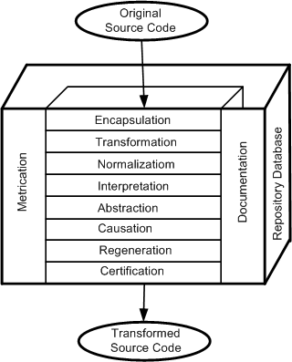
4.4.2 Source Code Reengineering Reference Model
The SCORE/RM model was proposed by Colbrook, Smythe and Darlison.
The framework, depicted in Figure, consists of four kinds of elements:
  function,
  documentation,
  repository database, and
  metrication.
The function element is divided into eight layers, namely:
  encapsulation, transformation,
  normalization, interpretation,
  abstraction, causation,
  regeneration, and certification.
Figure 4.6 Source code reengineering reference model © IEEE, 1990
Notes:
Handouts

Slide 24
4.4.2 Source Code Reengineering Reference Model
The eight layers provide a detailed approach to:
  (i) rationalizing the system to be reengineered by removing redundant data and altering the control flow,
  (ii) comprehending the software’s requirements, and
  (iii) reconstructing the software according to established practices.
The first six of the eight layers together constitute a process for reverse engineering, and the final three a process for forward engineering.
Improvements in the software as a result of reengineering is quantified by means of the metrication element.
The metrication element is described in terms of the relevant software metrics before executing a layer and after executing the same layer.
Notes:
Handouts

Slide 25
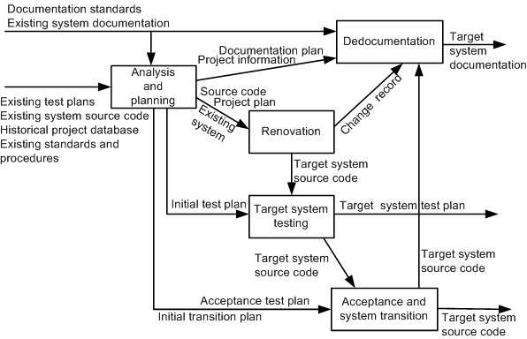
4.4.3 Phase Reengineering Model
The phase model of software reengineering was originally proposed by Byrne and Gustafson.
The model comprises five phases: analysis and planning, renovation, target system testing, redocumentation, and acceptance testing and system transition, as depicted in Figure 4.8.
The labels on the arcs denote the possible information that flows from the tail entities of the arcs to the head entities.
A major process activity is represented by each phase.
Tasks represent a phase’s activities, and tasks can be further decomposed to reveal the detailed methodologies.
Figure 4.8 Software reengineering process phases © IEEE, 1992
Notes:
Handouts

Slide 26
4.4.3 Phase Reengineering Model
1- Analysis and planning:
Analysis addresses three technical and one economic issue.
  The first technical issue concerns the present state of the system to be reengineered and understanding its properties.
  The second technical issue concerns the identification of the need for the system to be reengineered.
  The third technical issue concerns the specification of the characteristics of the new system to be produced.
The economic issue concerns a cost and benefit analysis of the reengineering project.
Planning includes:
  understanding the scope of the work;
  identifying the required resources;
  identifying the tasks and milestones;
  estimating the required effort; and
  preparing a schedule.
Notes:
Handouts

Slide 27
4.4.3 Phase Reengineering Model
2- Renovation:
An operational system is modified into the target system in the renovation phase.
Two main aspects of a system are considered in this phase:
  (i) representation of the system.
  It refers to source code, but it may include the design model and the requirement specification of the existing system.
  (ii) representation of external data.
  It refers to the database and/or data files used by the system. Often the external data are reengineered, and it is known as data reengineering.
An operational system can be renovated in many ways, depending upon the objectives of the project, the approach followed, and the starting representation of the system.
It may be noted that the starting representation can be source code, design, or requirements.
Notes:
Handouts

Slide 28
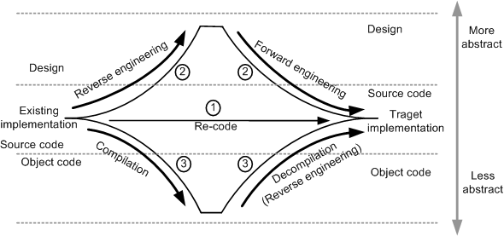
4.4.3 Phase Reengineering Model
2- Renovation … : Example
A project in which the objective is to re-code the system from Fortran to C.
Figure 4.9 shows the three possible replacement strategies.
First, to perform source-to-source translation, program migration is used.
Second, a high-level design is constructed from the operational source code, say, in Fortran, and the resulting design is re-implemented in the target language, C in this case.
Finally, a mix of compilation and de-compilation is used to obtain the system implementation in C
Figure 4.9 Replacement strategies for recording
Notes:
Handouts

Slide 29
4.4.3 Phase Reengineering Model
3- Target system testing:
In this phase for system testing, faults are detected in the target system.
Those faults might have been introduced during reengineering.
The same testing strategies, techniques, methods, and tools that are used in software development are used during reengineering.
For example, apply the existing system-level test cases to both the existing and the new system.
Assuming that the two systems have identical requirements, the test results from both the scenarios must be the same.
Notes:
Handouts

Slide 30
4.4.3 Phase Reengineering Model
4- Redocumentation:
In the redocumentation phase, documentations are rewritten, updated, and/or replaced to reflect the target system.
The two major tasks within this phase are:
  (i) analyze new source code, and
  (ii) create documentation.
Documents requiring revision are:
  requirement specification.
  design documentation.
  a report justifying the design decisions, assumptions made in the implementation.
  configuration.
  user and reference manuals.
  on-line help.
  document describing the differences between the existing and the target system.
Notes:
Handouts

Slide 31
4.4.3 Phase Reengineering Model
5- Acceptance and system transition:
In this final phase, the reengineered system is evaluated by performing acceptance testing.
Acceptance criteria should already have been established in the beginning of the project.
Should the reengineered system pass those tests, preparation begins to transition to the new system.
Upon completion of the acceptance tests, the reengineered system is made operational, and the old system is put out of service.
System transition is guided by the prior developed transition plan.
Notes:
Handouts

Slide 32
4.5 Code Reverse Engineering
Reverse engineering was first applied in electrical engineering to produce schematics from an electrical circuit.
In the context of software engineering, reverse engineering is defined as a process to:
  (i) identify the components of an operational software.
  (ii) identify the relationships among those components.
  (iii) represent the system at a higher level of abstraction or in another form.
Reverse engineering is performed to achieve two key objectives:
  redocumentation of artifacts
    It aims at revising the current description of components or generating alternative views at the same abstraction level. Examples of redocumentation are pretty printing and drawing CFGs(Control Flow Graphs).
  design recovery
    It creates design abstractions from code, expert knowledge, and existing documentation.
Notes:
Handouts

Slide 33
4.5 Code Reverse Engineering
Six objectives of reverse engineering :
  generating alternative views.
  recovering lost information.
  synthesizing higher levels of abstractions.
  detecting side effects.
  facilitating reuse.
  coping with complexity.
Six key steps in reverse engineering, as documented in the IEEE Standard for Software Maintenance, are:
  • partition source code into units.
  • describe the meanings of those units and identify the functional units.
  • create the input and output schematics of the units identified before.
  • describe the connected units.
  • describe the system application.
  • create an internal structure of the system.
The first three of the six steps involve local analysis, the rest involve global analysis.
Notes:
Handouts

Slide 34
4.6 Techniques Used for Reverse Engineering
The well-known analysis techniques that facilitate reverse engineering are:
      Lexical analysis.
      Syntactic analysis.
      Control flow analysis.
      Data flow analysis.
      Program slicing.
Notes:
Handouts

Slide 35
4.7 Data Reverse Engineering
Data Reverse Engineering (DRE) is defined as “the use of structured techniques to reconstitute the data assets of an existing system” .
By means of structured techniques, existing situations are analyzed and models are constructed prior to developing the new system.
The two vital aspects of a DRE process are:
  (i) recover data assets that are valuable;
  (ii) reconstitute the recovered data assets to make them more useful.
The purpose of DRE is as follows:
    1. Knowledge acquisition. 6. Data conversion.
    2. Tentative requirements. 7. Software assessment.
    3. Documentation. 8. Quality assessment.
    4. Integration. 9. Component reuse.
    5. Data administration.
Notes:
Handouts

Slide 36

4.7 Data Reverse Engineering
Reverse engineering of a data-oriented application, including its user interface, begins with DRE.
Recovering the specifications, that is the conceptual schema in database realm, of such applications is known as database reverse engineering (DBRE).
A DBRE process facilitates understanding and redocumenting an application’s database and files.
By means of a DBRE process, one can recreate the complete logical and conceptual schemas of a database physical schema.
The conceptual schema is an abstract, implementation independent description of the stored data.
A logical schema describes the data structures in concrete forms as those are implemented by the data manager.
The physical schema of a database implements the logical schema by describing the physical constructs.
Deep understanding of the forward design process is needed to reverse engineer a database.
Click-to Show the Video
Notes:
Handouts

Slide 37
4.7 Data Reverse Engineering
The forward design process of a database comprises three basic phases as follows:
  • Conceptual phase: In this phase, user requirements are gathered, studied, and formalized into a conceptual schema.
  • Logical phase: In this phase, the conceptual schema is expressed as a simple model, which is suitable for optimization reasoning.
  • Physical phase: Now the logical schema is described in the data description language (DDL) of the data management system and the host programming language.
A DBRE process is based on backward execution of the logical phase and the physical phase.
The process is divided into two main phases, namely,
  data structure extraction.
  data structure conceptualization.
The two phases relate to the recovery of two different schemas:
    (i) the first one retrieves the present structure of data from their host language
    representation.
    (ii) the second one retrieves a conceptual schema that describes the semantics
    underlying the existing data structures.
Notes:
Handouts

Slide 38
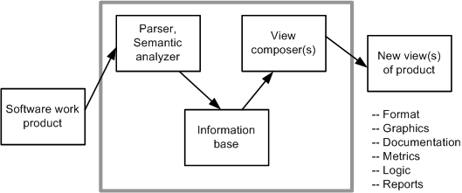
4.8 Reverse Engineering Tools
Software reverse engineering is a complex process that tools can only support, not completely automate.
There is a need of human intervention with any reverse engineering project.
The tools can provide a new view of the product, as shown in Figure 4.16.
The basic structure of reverse engineering tools is as follows:
  • The software system to be reverse engineered is analyzed.
  • The results of the analysis are stored in an information base.
  • View composers use the information base to produce alternative views of the system.
Figure 4.16 Basic structure of reverse engineering tools ©IEEE 1990
Notes:
Handouts

Slide 39
4.8 Reverse Engineering Tools
Ada SDA (System Dependency Analyzer) is a tool that supports analysis and migration of Ada programs.
CodeCrawler is a language independent reverse engineering tool which combines metrics and software visualization.
DMS (Design Maintenance System) toolkit developed by Semantic Design, Inc is composed of a set of tools for carrying out re-engineering of medium or large scale software systems.
FermaT is the generic name for a set of tools designed by Software Migration Ltd., specifically to support assembler code comprehension, maintenance, and migration.
GXL (Graph eXchange Language) is an XML-based format for sharing data between tools. GXL represents typed, attributed, directed, ordered graphs which are extended to represent hyper-graphs and hierarchical graphs.
IDA Pro Disassembler and Debugger by Hex-Rays is a powerful disassembler that supports more than fifty different processor architectures, including IA-32, IA-64 (Itanium), and AMD64.
IRAP (Input-Output Reengineering and Program Crafting) is a data reengineering tool developed by Spectra Research that provides a semi-automated approach to re-craft legacy software into an Intranet/Internet enabled application without compromising program computational integrity.
Notes:
Handouts

Slide 40
4.8 Reverse Engineering Tools
Hex-Rays Decompiler is a commercial decompiler plug-in for IDA Pro.
Imagix 4D is useful in understanding legacy C, C++, and Java software.
JAD (JAva Decompiler) is a Java decompiler written in C++.
ManSART is a tool to recover the architecture of a given software system.
McCabe IQ is capable of predicting some key issues in maintaining large and complex business software applications: (i) locate error-prone sections of code; and (ii) identify the risk of system failure.
PBS (Portable Bookshelf) is an implementation of the web based concept called Software Bookshelf for the presentation navigation of information representing large software systems.
RE-Analyzer is an automated, reverse engineering system providing a high level of integration with a computer-aided software engineering (CASE) tool developed at IBM.
Reengineering Assistant (RA) aims to provide an interactive environment where software maintainers can reverse engineer source code into a higher abstraction level of representation.
Rigi is a software tool for comprehending large software systems. Software comprehension is achieved by performing reverse engineering on the given system.
SEELA is a reverse engineering tool developed by Tuval Software Industries to support the documentation and maintenance of structured source code.
Notes:
Handouts

Slide 41
Summary
General Idea
Reengineering Concepts
A General Model for Software Engineering
Reengineering Process
Code Reverse Engineering
Data Reverse Engineering
Reverse Engineering Tools
Notes:
Handouts

